Slide 1
User Awareness & Training Event:
Parallel 3c –EMERGENCY (Room 1)
Bucharest, Romania – 7th November 2013
A.Priolo, D.Grandoni

Slide 2
Content – Demo and Training
Module 2: Live Demonstration: GIO Emergency services [40 mins]
Topics:
  Portfolio and Products analysis
  How to access the service (SRF compilation)
  User Feed Back
Tools:
  GIO EMS Portal
  (URL: http://emergency.
  copernicus.eu/mapping/)
  Printed map package
  GIO EMS USER GUIDE
Module 3: Exercise: Scenario Analysis and Service Activation [1h, 25 mins]
Topics:
  Scenario analysis
  AOIs definition
  Products selection
  SRF compilation
Tools:
  Doc file dossier:
    Scenario description
    Service Request Form
    User Feedback Form

Slide 3
Scenario description
Overview of the reference event:
Flash flood in Romania, 12th Sept 2013
(source: http://www.glidenumber.net/glide/public/search/details.jsp?glide=20069&record=2&last=34)
  Due to heavy rainfall in Romania that started on 12th September 2013 and lasted for more than 48 hours, many villages in several municipalities from the counties of Galati, Tulcea and Vaslui were flooded.
  The majority of these affected areas are situated in the rural and poorer part of Romania. Some villages have become completely isolated due to the damaged and / or not accessible bridges.
  The rivers that flooded were Taita in Tulcea, Suhu and Chineja in Galati.
  According to the information received from the Red Cross branches and the emergency departments in the affected municipalities, more than 1735 households have been affected by the flooding and 6901 people have been evacuated.

Slide 4
Scenario analysis
WITHOUT any interaction with the requesting user...
Flash flood in Romania, 12th Sept 2013
  WHAT: many villages flooded, some isolated (damaged and/or not accessible bridges)
  WHEN: 12th September 2013 (lasted for more than 48 hours)
  WHERE: Romania - Galati, Tulcea, Vaslui counties; Taita, Suhu, Chineja rivers
  WHY and HOW: heavy rainfall and consequent floods
  WHO: more than 1735 households have been affected by the flooding and 6901 people have been evacuated.

Slide 5
Scenario analysis
WITH interaction between service providers and requesting users:
  WHAT: many villages flooded, some isolated (damaged and/or not accessible bridges)…which villages? Where are they located? What is the functionality of the infrastructures? How to reach them (accessibility)? This are some examples of information needs for which we ask the GIO EMS activation
  WHEN: 12th September 2013 (lasted for more than 48 hours)…how are the weather forecasts for the coming days? This is an important information to be aware of, in order to agree with the service providers upon feasible products to be received
  WHERE: Romania - Galati, Tulcea, Vaslui counties; Taita, Suhu, Chineja rivers…which villages are located along the mentioned rivers? This is the crucial information for the AOIs selection!
  WHY and HOW: heavy rainfall and consequent floods…besides floods along the mentioned rivers, could we expect other secondary effects of the heavy rainfalls? For example, are the mentioned rivers tributaries of other? If so, where are the junctions located? In the surroundings, are there areas prone to landslides? All these reflections help to plan a proper and effective acquisition of satellite images, taking into account possible evolution of the on going event!
  WHO: more than 1735 households have been affected by the flooding and 6901 people have been evacuated. Which are the houses evacuated? Where are they located? Where could we safely accommodate the population evacuated? Tents camps? Buildings still functional? How are their accessibility conditions? This are other examples of information needs which might be satisfied by the GIO EMS products!

Slide 6
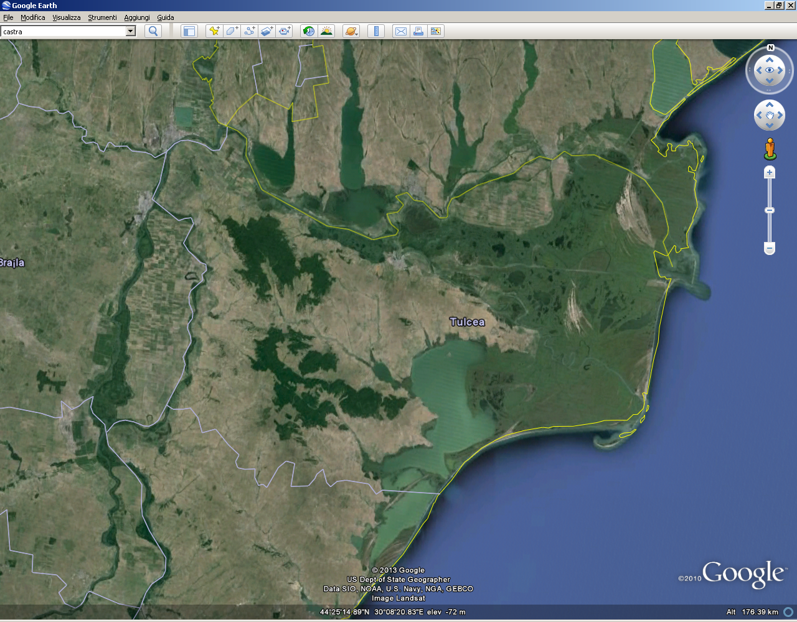
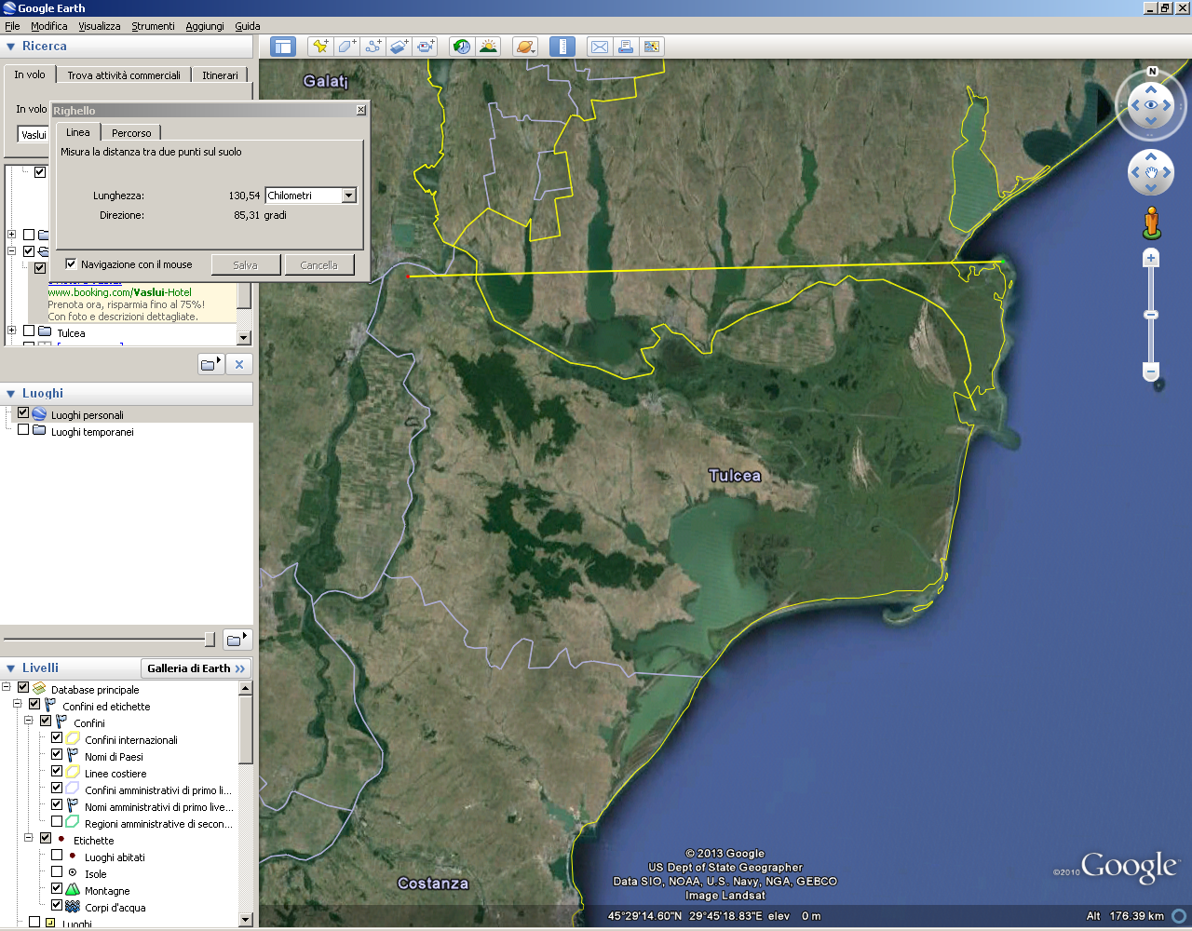
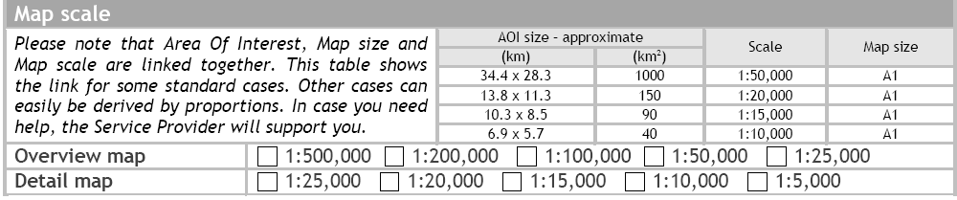
Areas Of Interest (AOIs) selection
Tulcea county
About 130 x 80 km = 10.400 Km²
1000 : 50.000 = 10.400 : x …therefore we would have 1: 520.000

Slide 7
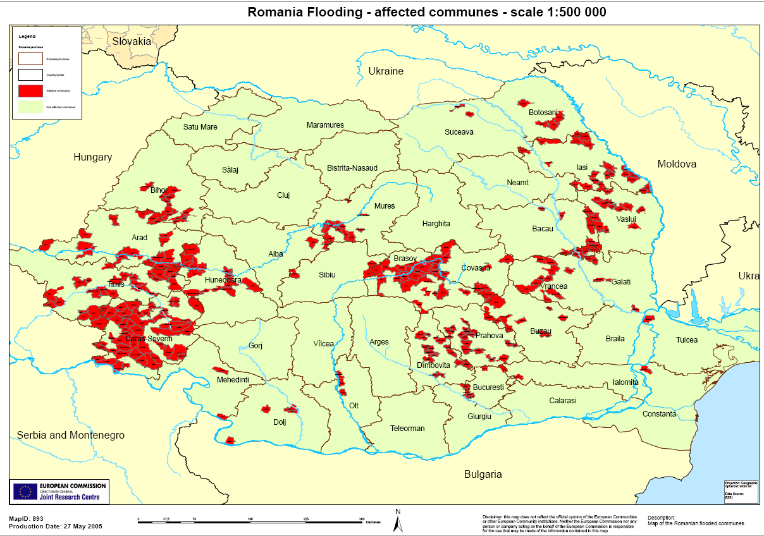
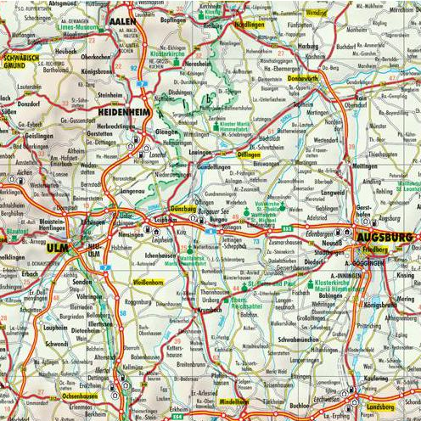

Areas Of Interest (AOIs) selection
Source: http://global-atlas.jrc.it/get_data.asp?FIPS=RO
Typical example
of a map
1:500.000
overview maps!
Typical example of a map 1:500.000
Street maps
Tourist guides
or…

Slide 8
Areas Of Interest (AOIs) selection
Overview map: which extension (and consequent scale)?
  INFO AVAILABLE
  INFO NEEDS
  “The rivers that flooded were Taita in Tulcea, Suhu and Chineja in Galati.”
  Which are the affected villages? Where are they located? (flood extension)
  How to reach the isolated villages? (accessibility)
  Which houses have been evacuated? Where are they located?
  Where could we safely accommodate the population evacuated? Tents camps? Buildings still functional? How are their accessibility conditions? Which bridges/roads cannot be used? (functionality)

Slide 9
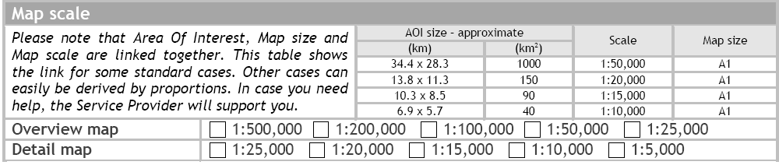
Areas Of Interest (AOIs) selection
  Choose the best possible envelope of the areas, according to our need of information!
  OVEVIEW MAPs should provide the “big picture” of what is going on.
  At the same time, the smaller is the AOI, with better details (the bigger the scale)…
Key word: COMPROMISE!

Slide 10
Areas Of Interest (AOIs) selection
  15’ to select the AOIs for overview maps
  TIPS FOR THE EXERCISE:
  Taita (Tulcea), Suhu and Chineja (Galati)
  flood extension
  Accessibility

Slide 11
Areas Of Interest (AOIs) selection
Detail map: which extension (and consequent scale)?
  INFO AVAILABLE
  INFO NEEDS
  “many villages flooded, some isolated (damaged and/or not accessible bridges) .”
  “more than 1735 households have been affected by the flooding and 6901 people have been evacuated”
  Which are the affected villages? Where are they located? (flood extension)
  How to reach the isolated villages? (accessibility)
  Which houses have been evacuated? Where are they located?
  Where could we safely accommodate the population evacuated? Tents camps? Buildings still functional? How are their accessibility conditions? Which bridges/roads cannot be used? (functionality)

Slide 12
Areas Of Interest (AOIs) selection
  Choose the best possible envelope of the areas, according to our need of information!
  DETAIL MAPs should provide the “zoom in” on particularly critical areas.
  And again, the smaller is the AOI, with better details (the bigger the scale)…
Key word: COMPROMISE!

Slide 13
Areas Of Interest (AOIs) selection
  20’ to select the AOIs for detail maps
  TIPS FOR THE EXERCISE:
  Each “AOI for detail map” have to be chosen within an “AOI for overview map”
  You can choose more then one “AOI for detail map” within a single “AOI for overview map”
  “Functionality” (houses/camps/buildings/bridges/roads/…)

Slide 14



Product selection
  INFO NEEDS
Reference
  Which villages are located along the Taita (Tulcea), Suhu and Chineja (Galati) rivers?
  Are the mentioned rivers tributaries of other? If so, where are the junctions located?
  In the surroundings, are there areas prone to landslides?
  Are there critical plants/lifelines exposed to the on going event?
Toponyms, admin boundaries, settlements
Hydrology
Physiography, landcover + user’s data?
Transport, industry and utilities
Delineation
Affected settlements
  Which are the affected villages? Where are they located? (flood extension)
  How to reach the isolated villages? (accessibility)
  Which houses have been evacuated? Where are they located?
  Where could we safely accommodate the population evacuated? Tents camps? Buildings still functional? How are their accessibility conditions? Which bridges/roads cannot be used? (functionality)
Affected lifelines
Grading
Functionality
Damage level
Functionality
Notes:
Base layer
Hydrology: rivers, lakes, reservoirs and open water, etc
Toponyms and administrative boundaries
Physiography: cliffs, contours and spot heights, etc
Land cover: cropland, grassland, scrub, forest, natural vegetation, bare soil, wetlands, etc
Settlements, both formal (urban, suburban, rural, etc) and informal (slums, IDP camps, etc)
Transport: all transport networks and related infrastructure (e.g. roads, tracks, trails, railways, bridges, harbours, and airfields)
Industry and Utilities: industrial facilities and power stations

Slide 15
SRF (Service Request Form) compilation
Link to the Service Request Form

Slide 16
UFF (User Feedback Form) compilation
Link to the AU User Feedback Form
Link to the End User Feedback Form

Slide 17
Questions?
Notes:
Feedback forms will be distributed and people will be encouraged to complete them in this time.
Open floor up to questions.

Slide 18
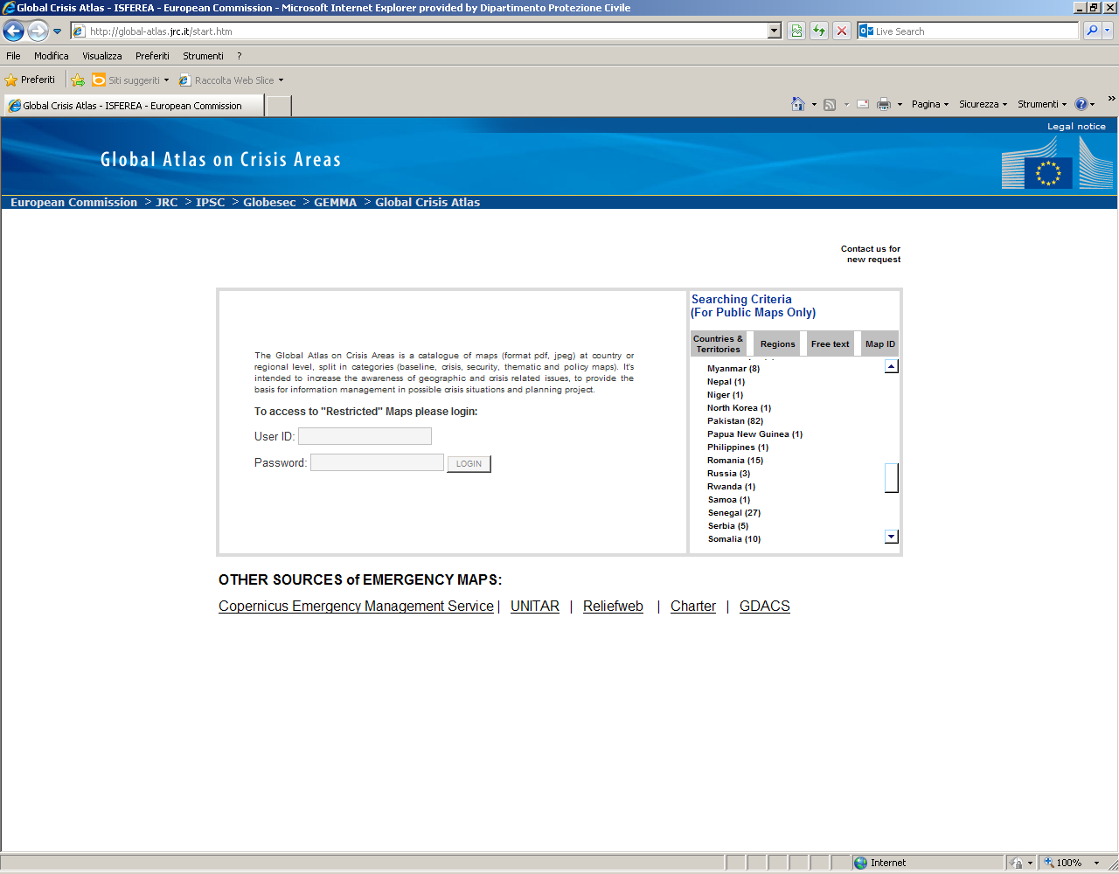
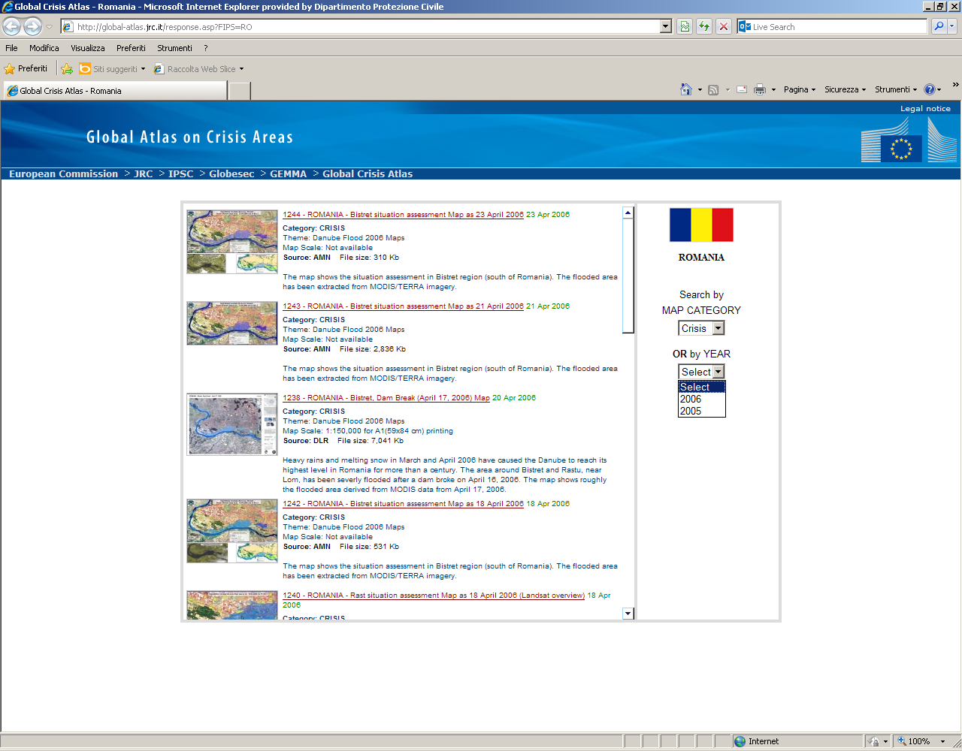
...
Scenario analysis
Source: http://global-atlas.jrc.it/

